Slide 1

Online General Store
Batch - 86
Team Member -
Srinivas Manjunath
Sujan Prabhakar
Prajna C
Prateek Srivastava

Slide 2
Introduction
An online grocer is either a brick and mortar supermarket or grocery store that allow online ordering , or a standalone e-commerce service that includes grocery items. The project is implemented with regard to buying and selling of the groceries. This project provides the users basically the online grocer and the customers an interface to buying and selling of the groceries. Our project provides the simple and easy GUI for the users.

Slide 3

Problem Statements
This project aims to develop an online grocery shopping for customer with the goal so that it would be easy to shop the important groceries that are required day to day life
To get to this online shopping all the customer will need to have a email and password to login and proceed the shopping. Upon successful login the customer can purchase a wide range of groceries.
The online grocer requires an email and password to maintain and manage the products and the orders.

Slide 4

Platform and Technologies used
Platform – Intelli J , MySQL Workbench.
Frontend – HTML , CSS, JavaScript.
Backend - Java , SQL.

Slide 5

Dependencies Used
Spring Boot Starter Web.
Spring Boot Devtools.
Spring Boot Starter Tomcat.
JDBC
Spring Boot Web Services.

Slide 6

Business Requirement
The online grocer should be able to insert the items one by one by along with their description and price. The online grocer should be able to control the users and orders and check status and update the status of the orders and also remove the customers along with that should be able to view the contacts.
The user can create an account view the items available in that grocery story and add them to cart. The total amount of all the items should be calculated and must be shown to the user the all the items along with their delivery status.
Once the delivery is done online grocer/admin should be able to change the delivery status to delivered.

Slide 7
Proposed Solution
The customer and the admin are the two parties which are allowed to have access to the database of the system and have different view level schemas’ to the database information
The customers are privileged with the following services: Register as a customer by providing certain personal details. View products and add them to the cart also remove and change items. View orders details.
Due to the pandemic the online retailing has increased this website could be a supportive platform for local grocery stores in order to stay in business.

Slide 8
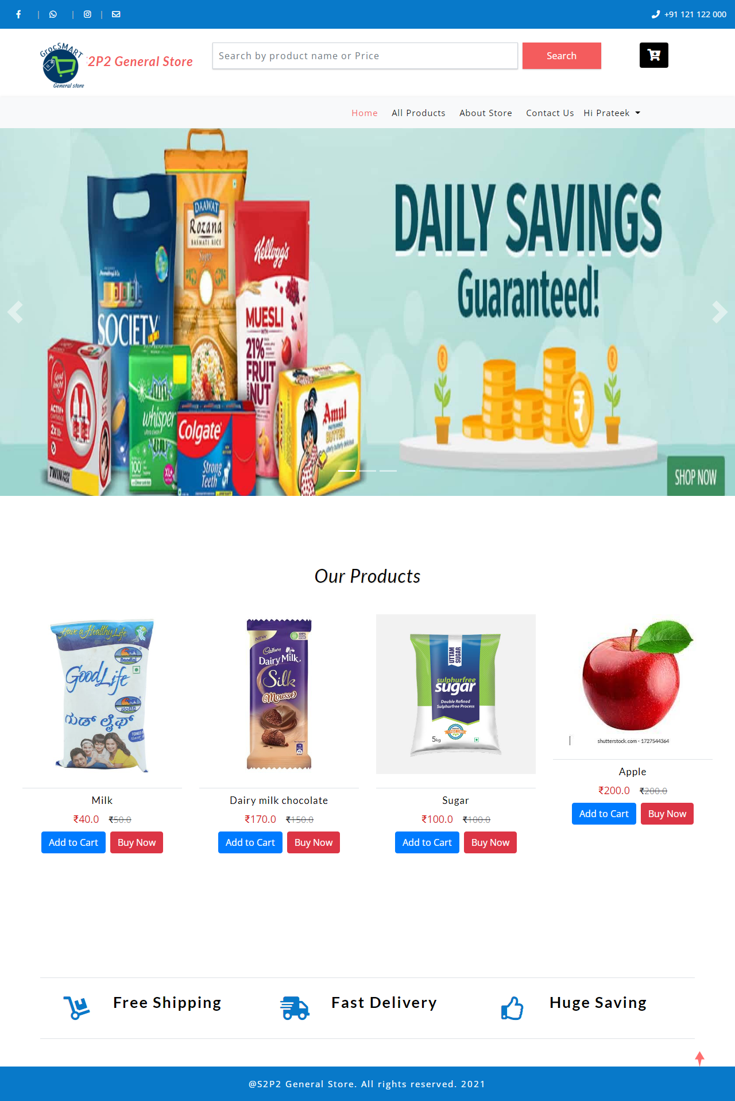
Screen Shots
Home Page

Slide 9
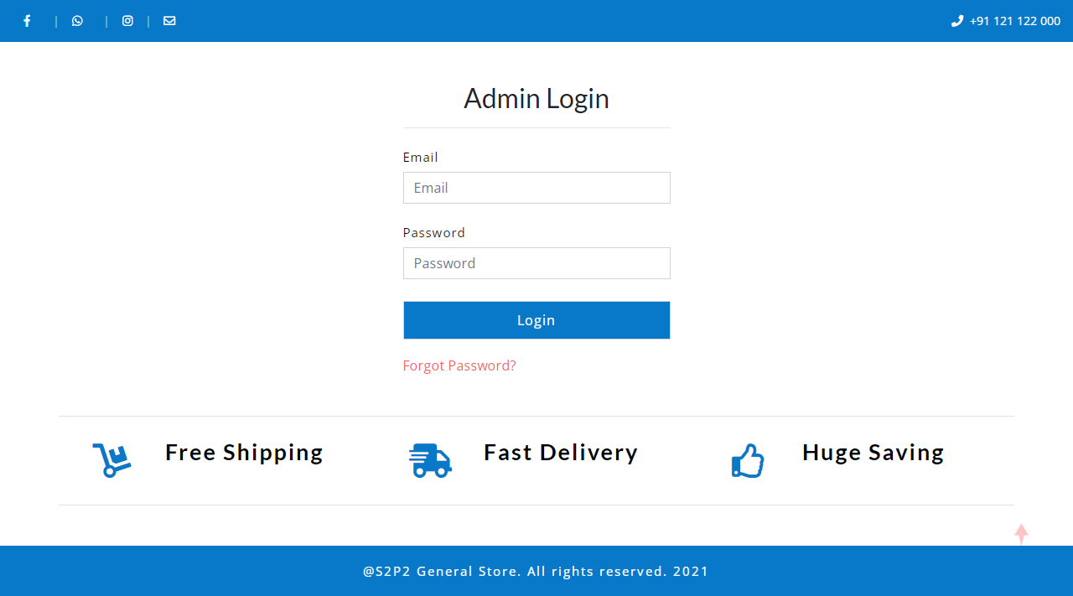
Admin Login

Slide 10
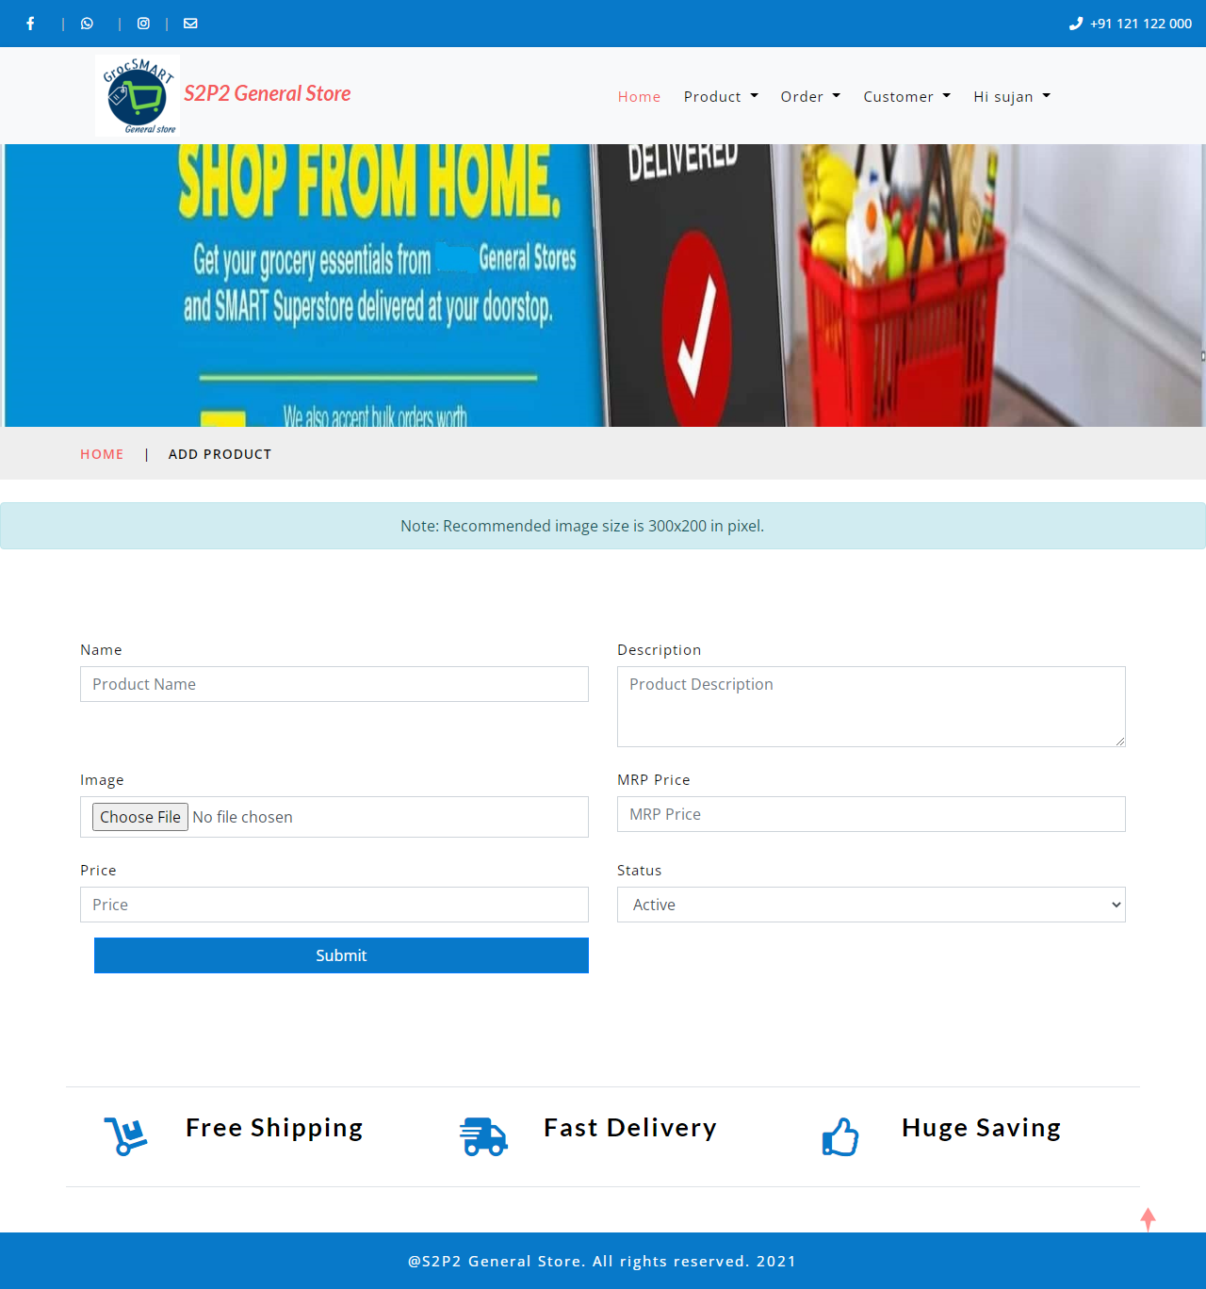
Adding Products

Slide 11
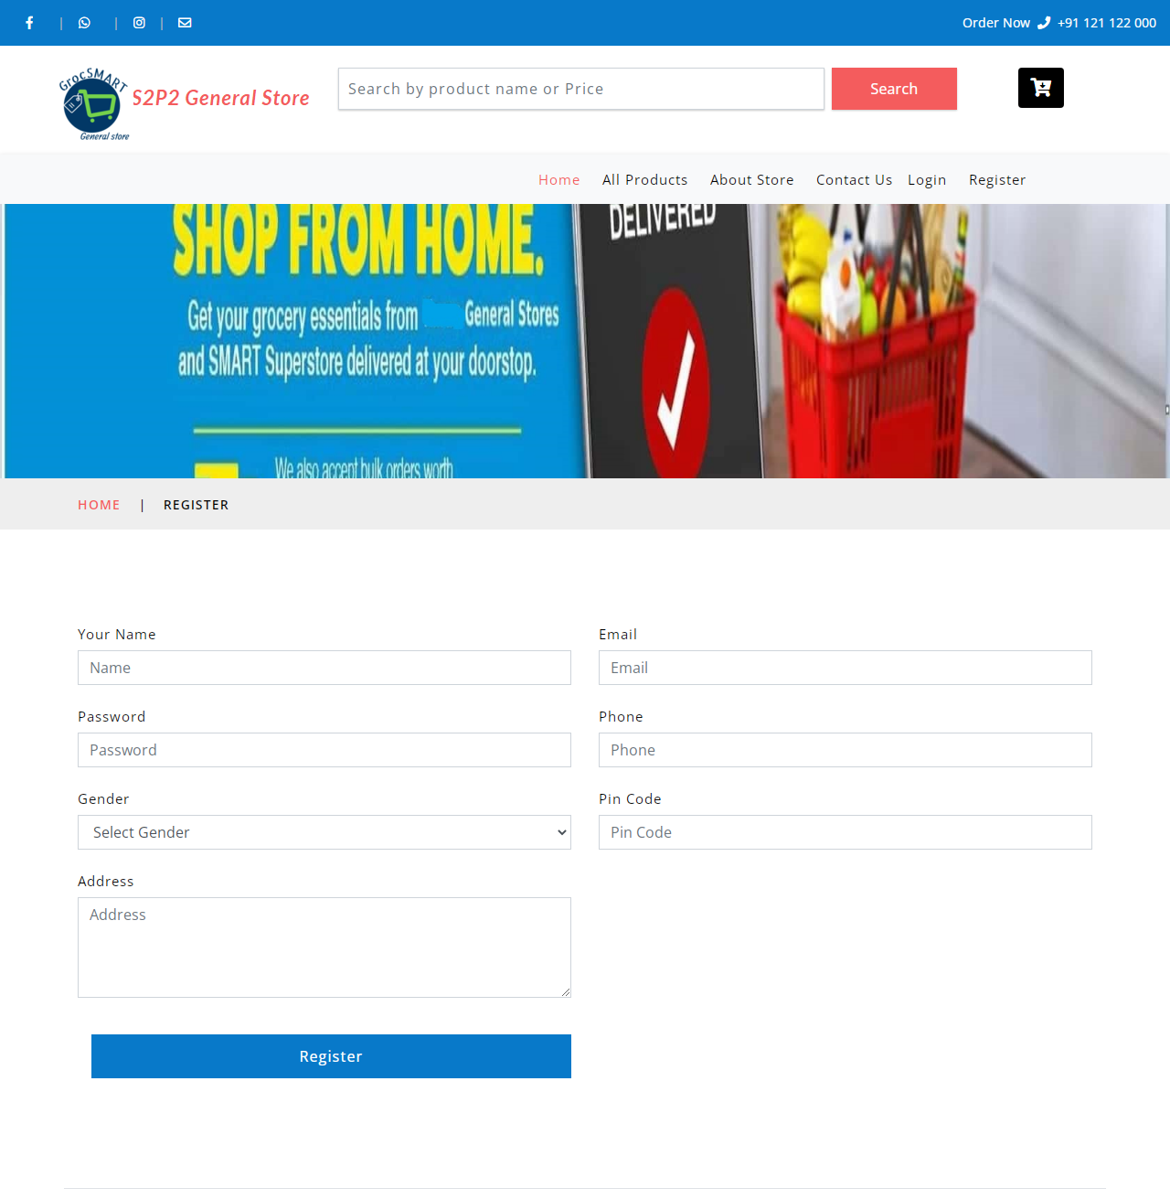
User Registration Page

Slide 12
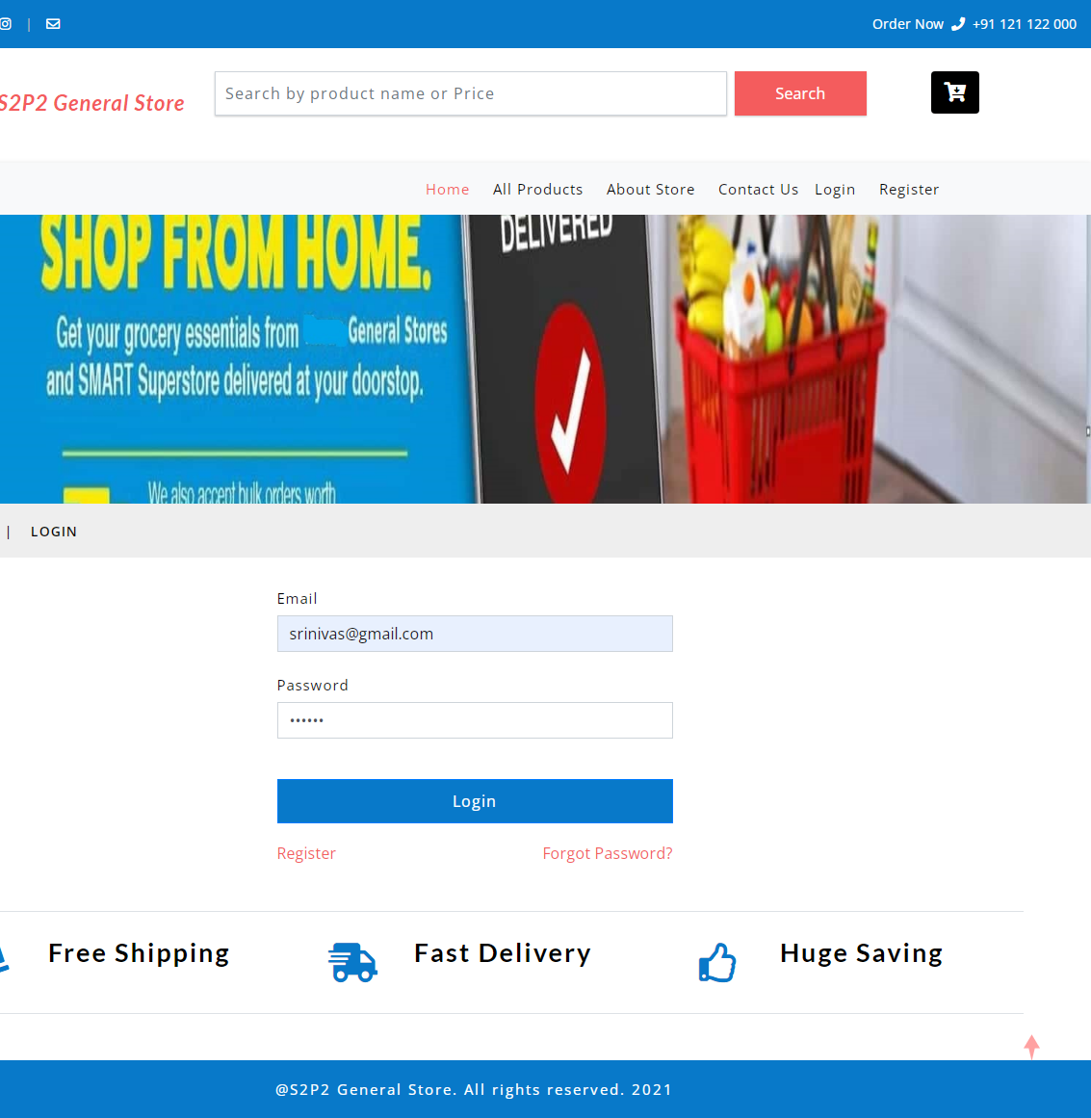
User Login

Slide 13

Products

Slide 14
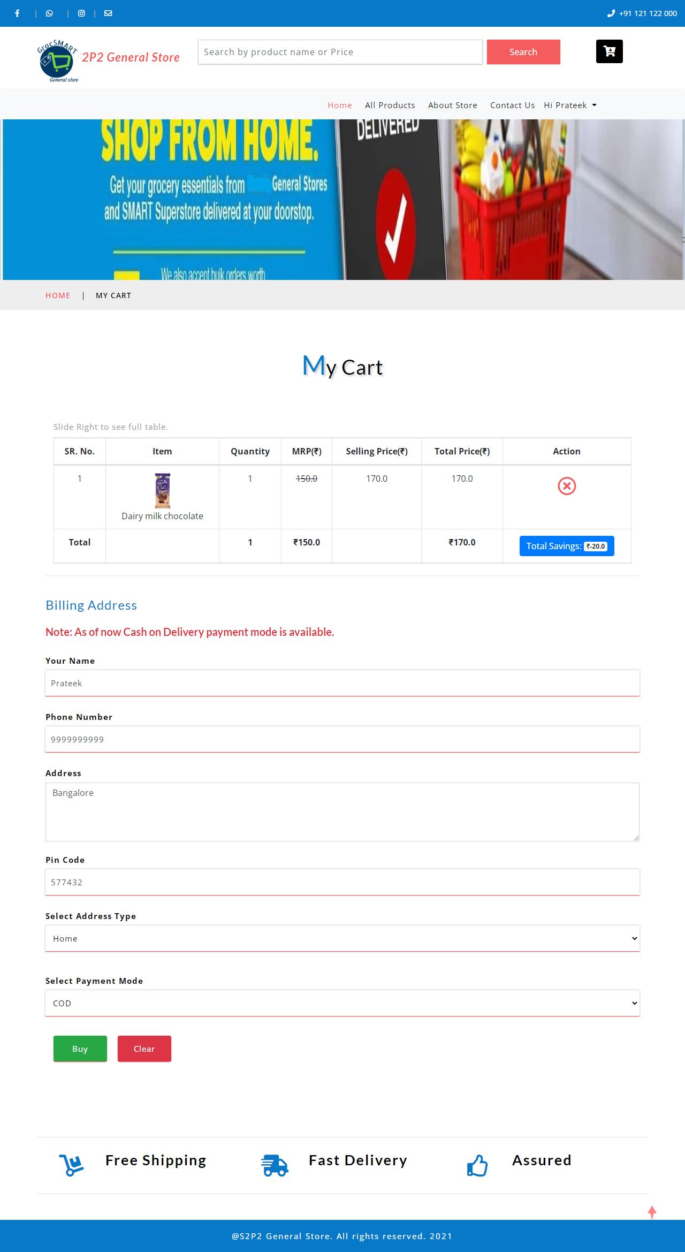
Cart

Slide 15
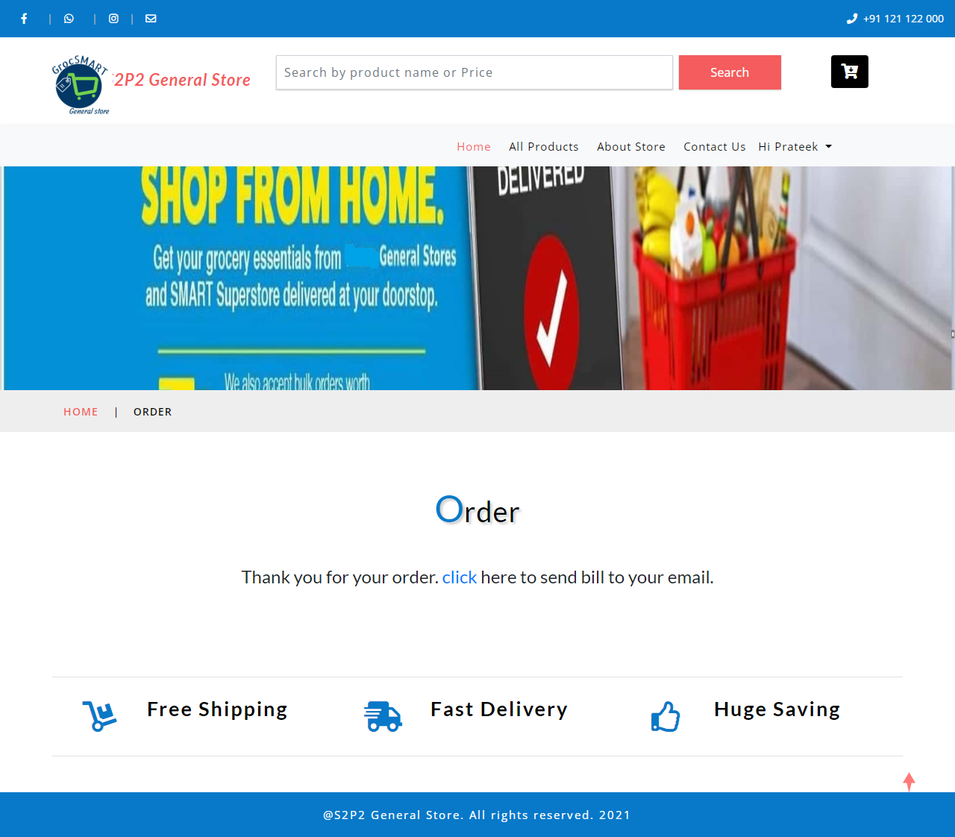
Confirm Order

Slide 16

Thank You

